Slide 1
Anaesthesia and Caring for Patients During the COVID-19 Outbreak
By: Dr. Jalil Makarem
Associate Professor of Anaesthesiology & Critical Care
IKHC-TUMS

Slide 2
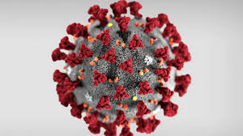

Slide 3
World cases of COVID-19 ( 19th Sep.)
Coronavirus cases: 30,815,278
Death: 958,232 (4% )
Active case: 7,420,084
Serious cases: 1%

Slide 4
Iran cases of COVID-19 ( 19th Sep.)
Coronavirus cases: 419,043
Death: 24,118 (6% )
Active case: 37,293
Serious cases: 10%

Slide 5
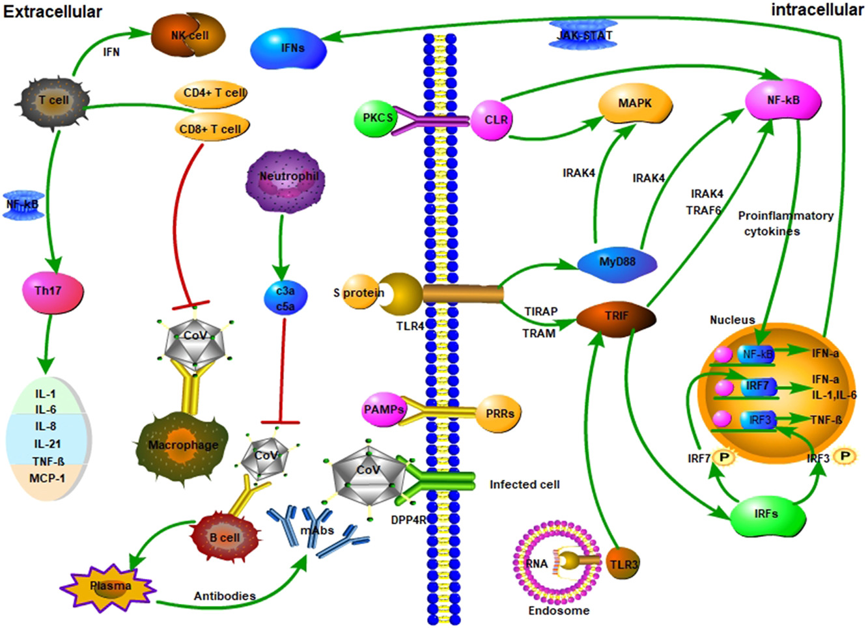
Immunologic involvement

Slide 6
Multi-organ Involvement
Respiratory involvement: Upper & Lower system
Gastrointestinal system and Liver involvement
CNS and PNS
Kidney involvement
Cardiac involvement
Hematologic system

Slide 7
Approaching in Operating Room during pandemic COVID- 19
Patient groups :
Low risk patients for COVID during the pandemic having elective surgery
Suspect/probable/confirmed COVID patients having emergent surgery

Slide 8
A) Low risk patients having elective surgery (need in-patient care)
1) Indication of surgery, is it essential or can be postponed?
2) Screen for COVID-19 risk factors (Taking History-contact, trip- ,symptoms or T>38)
3) Requirement of admission? No: proceed , Yes: considerations needed
4) PPE as usual (pandemic, OR condition)
5) Routine, droplet or airborne precautions
6) Extubation with minimal coughing
7) In Recovery: Oxygen <15L/min
8) Discharge advice to report any respiratory symptoms or change in COVID-19 status
9) Discharge from PACU

Slide 9
A) Low risk patients having elective surgery (need in-patient care)
1) ICU admission / blood transfusion/ post op long-time rehabilitation? Assessment to ICU admission Indication of surgery, is it essential or can be postponed?
Yes: Delay or Cancel Case No: Proceed and then admit the patient
2) ASA class:
I or II: Proceed
III: CHF/ COPD/ Asthma # Age> 65y # immunosuppression: Delay or Cancel
IV or IV: Delay or Cancel

Slide 10
B) Suspect/probable/confirmed COVID patients having emergent surgery
1) Evaluate the indication of operation
2) Plan secure patient transport to theatre
3) Plan patient flow through theatre
4)Remove unnecessary items
5)Plan whether intubation will occur in a negative pressure room or whether theatre can be converted to negative pressure
6) Extra staff member for control infection
7) Dedicated PPE buddy
8) Airborne precautions PPE
9) Intubation precautions

Slide 11
B) Suspect/probable/confirmed COVID patients having emergent surgery
10) Intra-operative: Lung protective ventilation strategies / Forced air warming blankets???
11)Extubation: in theatre, minimize coughing
12) Recover in theatre if possible
13)Plan secured patient transport from theatre
14)Maintain airborne precautions for staff entering theatre for at least 30mins or according to local guidance, depending on the number of air changes per hour
15)Terminal clean

Slide 12
Operation in patients in covid incubation period.
34 patients
Elective surgeries during the incubation period of COVID-19
All developed COVID-19 pneumonia shortly after surgery
44.1% of patients needed intensive care postoperatively
The mortality rate was 20.5%
Probable lowering of cell-mediated immunity after surgery which is vital for defense against viral infections is the cause
Lei S, Jiang F, Su W, Chen C, Chen J, Mei W, Zhan LY, Jia Y, Zhang L, Liu D,Xia ZY, Xia Z. Clinical characteristics and outcomes of patients undergoing surgeries during the incubation period of COVID-19 infection. EClinicalMedicine. 2020;21:100331

Slide 13
Operation Condition
The negative pressure : the anteroom and the induction room
The positive pressures: The scrub area and the main operating room
25 air exchange cycles per hour in main Operating room
Airflow to minimizing the risk of infection
Operating rooms positive pressure to prevent intraoperative contamination
high-efficiency particulate air (HEPA) filters effective
+ High-frequency air exchanges

Slide 14
Zones of the operation theatre

Slide 15
Environment cleaning
A route between triage to induction room, OR and then to recovery rooms should be frequently cleaned and disinfected.

Slide 16
The surgeon and the theatre staff
Corona OR should be different
In Zone 1 : a disposable surgical scrub suit, surgical boots, waterproof boot and a waterproof apron should be donned.
Surgicalhand preparation with water and chlorhexidine gluconate
The surgeon use either N95 or FFP 2 mask
Powered airpurifying respirators [PAPR] for longer operations
Double surgical masks : avoided
Eye protection equipment
Full face shield or goggles

Slide 17
The surgeon and the theatre staff
In zone 2 :a surgical spacesuit or the second layer of sterile protective garments
An aqueous alcohol solution is used for scrubbing.
The first pair of gloves then a sterile surgical scrub suit and second pair of gloves
Surgical gowns
Surgical caps
surgical hood with ties should for the head and the neck for aerosol-generating procedures
Shoes or booties fluid resistant
double high cuffed surgical gloves

Slide 18
The surgeon and the theatre staff
After the surgery the staff exits through zone 4
zone 5 the scrub suit is removed and bathing
Strict and frequent screening of the segregated OR staff is mandatory
Members of the segregated or exposed staff should immediately report any signs of illness
must be taken off duty immediately.
All contact events between patients and staff must be recorded so that contact tracing and infection control

Slide 19
Anesthesia considerations
The most experienced anesthesiologist should intubate the patients.
the same anesthesia machine for COVID cases.
A heat and moisture exchanger (HME) filter is used on the expiratory limb of the circuit.
The soda-lime and filters are exchanged after each case.
Disposable airway equipment is to be used.
The airway should be secured with the method which has the highest chance of first-time success especially video-laryngoscope [20].
Airway manipulation, face mask ventilation, and open airway suction should be minimized.
Bag mask ventilation should be avoided

Slide 20
Anesthesia considerations
A dedicated transport ventilator for a patient transferred directly from ICU
During switching from the portable device to the OR ventilator, the gas flow should be turned off and the endotracheal tube clamped with forceps
Regional anesthesia is preferable.
Nasal Oxygen should be administered under the surgical mask.
Antiemetics should be used to reduce post-operative retching
In ICU intubation before transport to OR

Slide 21
How to transfer
Go to ward or ICU by the ward nurses
Full personal protective equipment N95 mask, goggles, or face shield, splash-resistant gown, and boot covers
Coming from the ICU, a dedicated transport ventilator with a High-Efficiency Particulate Air (HEPA) filter
HEPA filter 1 between the endotracheal tube and the circuit
HEPA filter 2 between the circuit and ventilator.
Two members of hospital security escort with transport team
OR with separate access
Short transfer routes
Same transport personnel

Slide 22
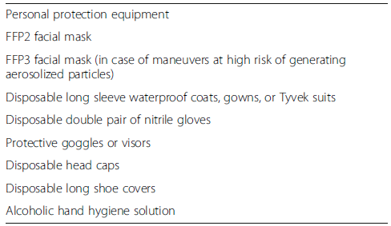
Personal protection equipments

Slide 23
Intraoperative protocol
Air exchange cycles ≥ 25 exchanges/h between surgeries
Bodily fluids or tissue samples
Surgeons and personnel should remain outside the operating room until anesthesia induction and intubation
Minimum personnel should be placed in the operating room
Only minimum required supplies were opened in the procedure room
The additional supplies needed for the case which were placed on a cart in the containment room and transported into the OR only when the outside door was shut.

Slide 24
Intraoperative protocol
No additional phones or breaks/
changes in staff should be allowed
A smoke evacuator with electrocautery
Electrosurgery should be minimized or excluded
Bulb syringes should be used for lavage
In trauma and orthopedic surgical procedures limited use of electrocautery, bone saws, reamers, etc

Slide 25
Intraoperative protocol
Disposable medical equipment
A sharp injury to the PPE avoided
bisposal of Body fluids, blood, secretions, pathological specimens in double sealed bags
Any specimens labeled and kept special containment
The theatre is to be disinfected between surgeries
The disinfecting personnel should enter the theatre only after enough air changes

Slide 26
Intraoperative protocol
If possible, one surgery daily in that OR
Theatre disinfected with UV light
The instruments must be labeled before sending to sterilized unit
The staff in the unit must be made aware of the covid status of the case
Wearing a full PPE staff of sterilized unit
The risk in theatres might be more in resource constrained settings
Aerosols can be generated either by surgery or by the respiration of the patient
ENT, Neurosurgery, and Opthalmology surgeons are at risk from both types of aerosols
Orthopedic surgeons are exposed to high levels of surgical aerosol but a lower risk of respiratory aerosol.

Slide 27
Laparoscopic surgeries precautions
Reduce CO₂ release
(a) closing the port taps before insertion
(b) attaching a CO₂ filter to one of the ports for smoke evacuation
(c) not opening the tap of any ports unless they are attached to a CO₂ filter or being used to deliver the gas
(d) reducing the introduction and removal of instruments through the ports
(e) deflating the abdomen with a suction device before removing the specimen bag from the abdomen
(f) deflating the abdomen with a suction device and via the port with a CO₂ filter at the end of the procedure
(g) minimizing the use of cauterization

Slide 28
Recovery and postoperative
become proactive rather than reactive!
Continuing concerning safety measures !
All therapeutic and non-therapeutic staff and patients should be involved!

